Slide 1


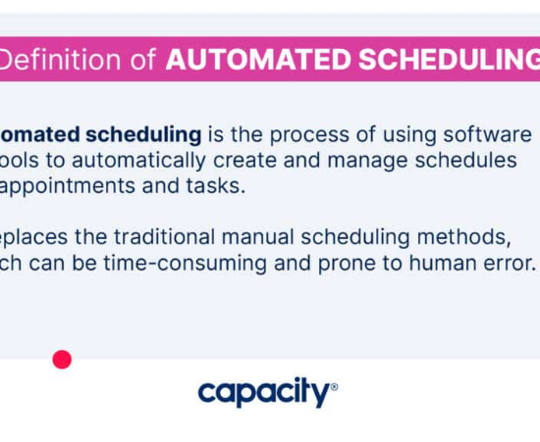
Introduction: The Need for Automation
Currently, scheduling a Council Member requires manual coordination across multiple teams and calendars. This creates bottlenecks and increases the risk of double-booking.
Our Mission: To replace manual email chains with a modern, automated system.
•
Faster Responses: Instant feedback for the public.
•
Accuracy: No more human error in calendar checks.
•
Efficiency: Frees up staff for higher-value work.

Slide 2










Project Objectives & Goals
Two Ways to Request
Smart Scheduling
We will build two simple forms: one for the Public (website) and one for Internal Staff. Both feed into the same smart system.
The system will automatically check 8 calendars (7 individuals + 1 master) instantly to prevent conflicts before they happen.
Legal Compliance (KOMA)
Centralized Data
We ensure compliance with the Open Meeting Act by intelligently grouping officials (e.g., 3-2-2 pattern) to avoid quorum violations.
All records are stored securely in SharePoint Lists and synced to the Master Outlook Calendar for total visibility.

Slide 3

Image Sources
https://capacity.com/wp-content/uploads/2023/05/2023-How-to-Automate-Scheduling-Definition-Automated-Scheduling-1024x576.jpg
Source: capacity.com

